Slide 1

Object Detector for Road Signs
By Ka Hung Lee

Slide 2

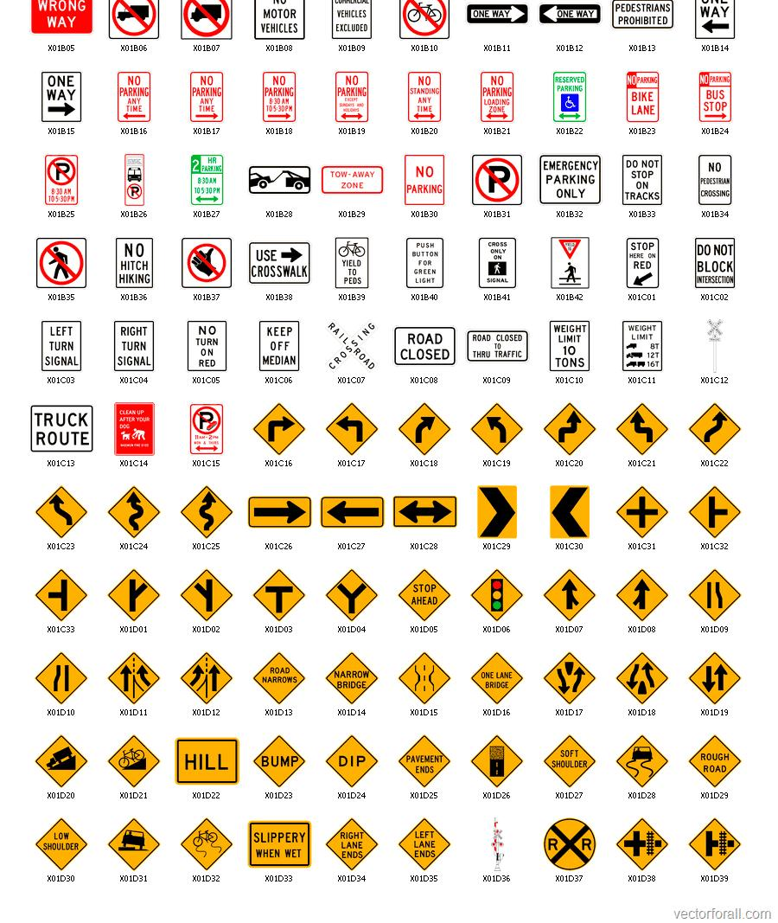
Motivation
Roads and motorways are essential infrastructure that physically connects places together
They also provide ease of assess for vehicles to travel
Road signs or traffic signs are constructed to guide or provide instructions for road users

Slide 3
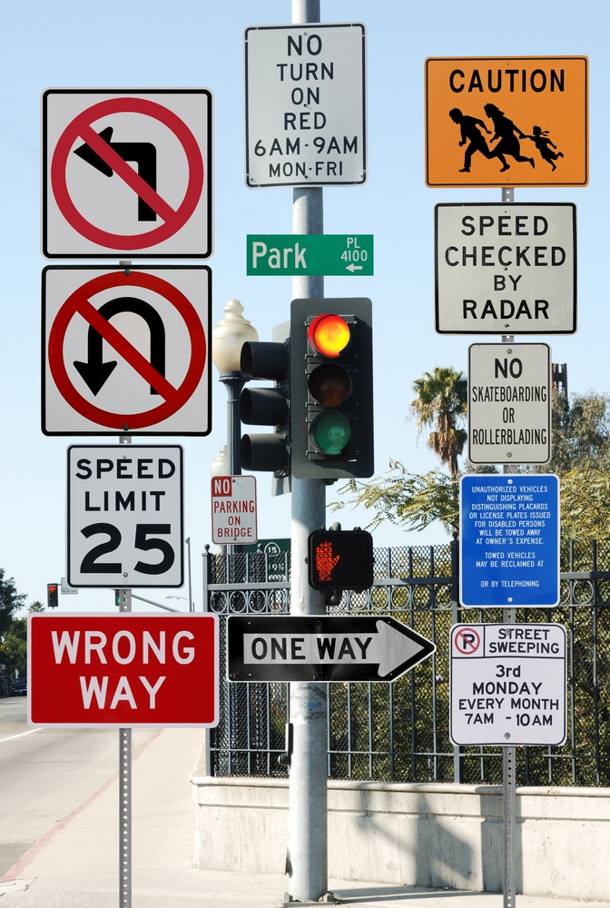
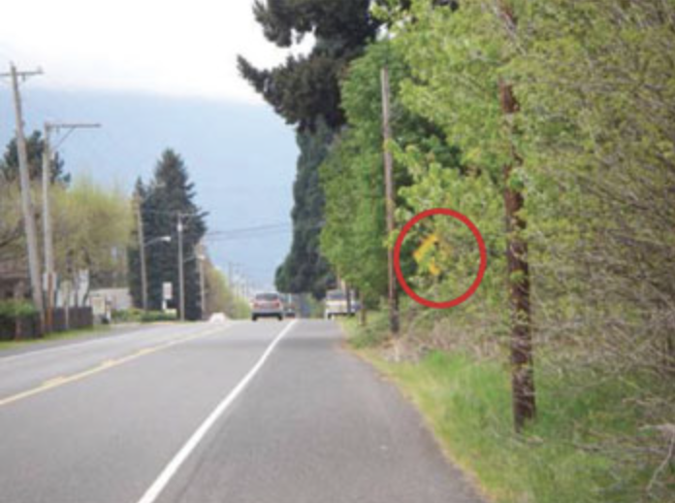
Where is that sign?
However, there could be times when user wish to:
Locate/Identify specific road signs
Be made aware of upcoming road signs
To solve this problem, we could create a program that could detect specific road signs

Slide 4
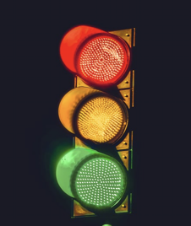
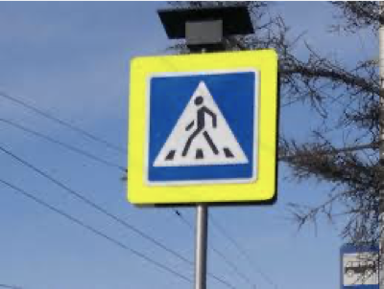
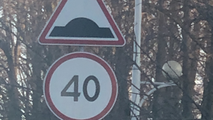
Data
Source: https://www.kaggle.com/andrewmvd/road-sign-detection
877 images with 4 classes (trafficlight, stop, speedlimit, crosswalk)
Existing labels were modified with 2 additional classes using LabelImg (nostop, yield)
100 images were added through image augmentation to increase the sample size of yield

Slide 5
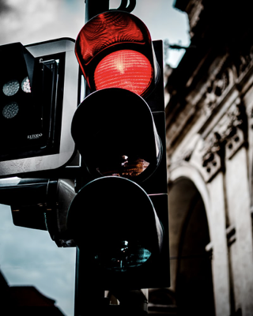
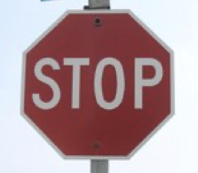
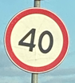
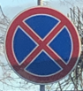
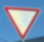
Number of Labels
The dataset was partitioned roughly 9:1 (training/validation split)
Label Name
trafficlight | stop | speedlimit | crosswalk | nostop | yield
Total
176 labels | 93 labels | 862 labels | 298 labels | 107 labels | 111 labels
Training Size
162 labels | 77 labels | 780 labels | 263 labels | 97 labels | 94 labels
Validation Size
14 labels | 16 labels | 82 labels | 35 labels | 10 labels | 17 labels

Slide 6
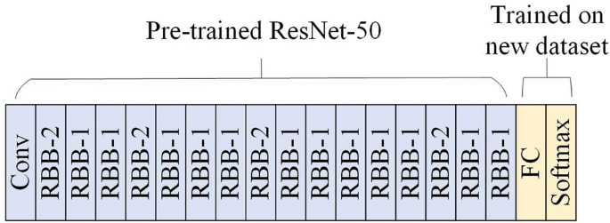
Our Model
Our model utilizes the saved weights of a pre-trained Retinanet Object Detection model (SSD with Resnet 50 v1) to train our customized model
The model was trained for 25000 steps (2000 warm-up steps)

Slide 7
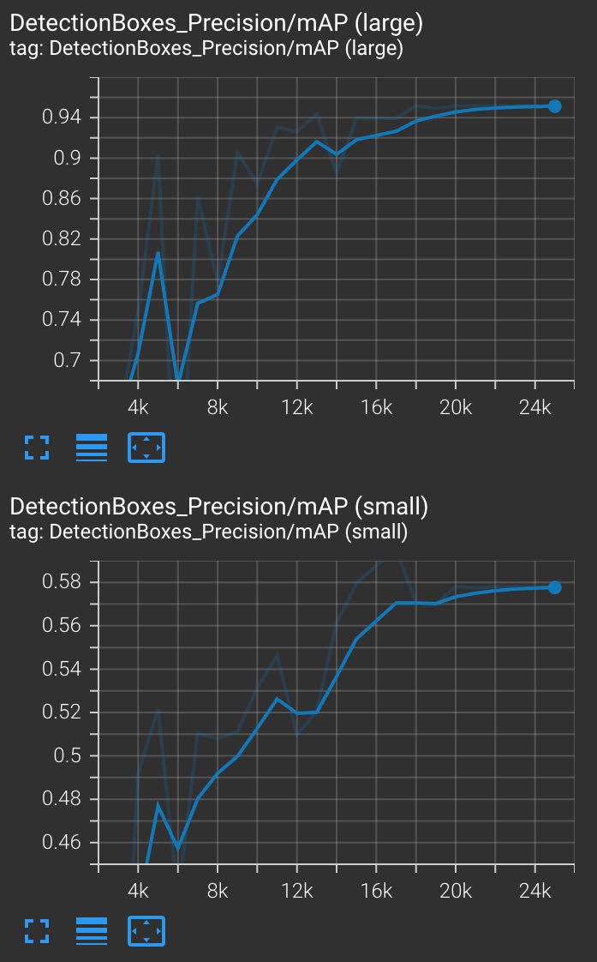
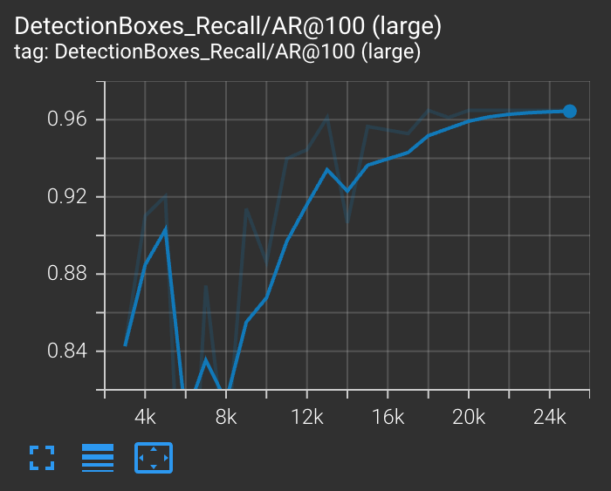
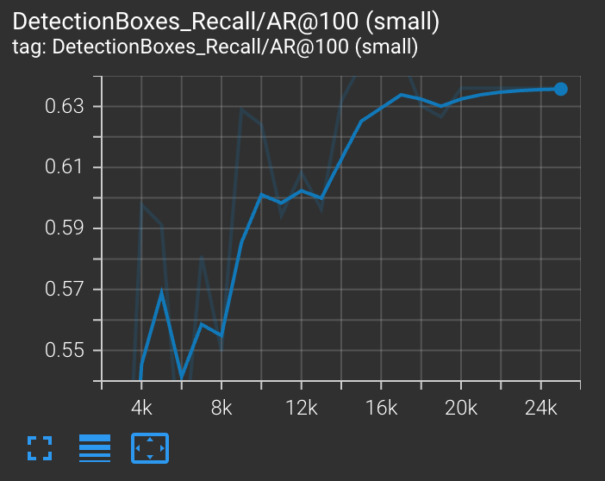
Model Performance (Validation Set)
Precision
Recall
For static images, the model perform well for large objects, and less so for small objects

Slide 8
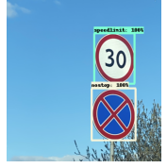
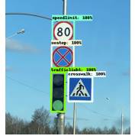
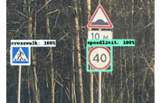
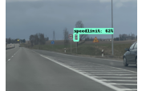
Validation Set

Slide 9
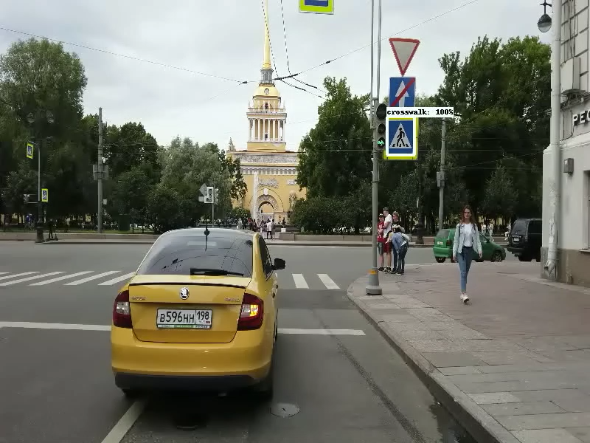
Video Test and Conclusions
The model was able to detect objects on video
Apparent issues:
Detection for yield is spotty
Cars are mistaken for trafficlights
Certain road signs can only be detected close up

Slide 10
Potential Improvements
Include more size variation for labels
Include images of labels in traffic settings
Increased sample size

